Slide 1
Public Key Cryptography

Slide 2


Basic Problem
public key
private key
Alice
Bob
Given: Everybody knows Bob’s public key
- How is this achieved in practice?
Only Bob knows the corresponding private key
Goals: 1. Alice wants to send a secret message to Bob
2. Bob wants to authenticate himself

Slide 3
Applications
Encryption for confidentiality
  Anyone can encrypt a message
    With symmetric crypto, must know secret key to encrypt
  Only someone who knows private key can decrypt
  Key management is simpler
    Secret is stored only at one site: good for open environments
Digital signatures for authentication
  Can “sign” a message with your private key
Session key establishment
  Exchange messages to create a secret session key
  Then switch to symmetric cryptography

Slide 4
Key Exchange
Alice
Bob
KEY
KEY
Alice
Bob

Slide 5
Diffie-Hellman Protocol
Alice and Bob never met and share no secrets
Public info: p and g
  p is a large prime number, g is a generator of Z_{p}*
    Z_{p}*={1, 2 … p-1}; ∀a∈Z_{p}* ∃i such that a=g^{i} mod p
    Modular arithmetic: numbers “wrap around” after they reach p
Pick secret, random Y
Pick secret, random X
g^{x} mod p
g^{y} mod p
Alice
Bob
Compute k=(g^{y})^{x}=g^{xy} mod p
Compute k=(g^{x})^{y}=g^{xy} mod p

Slide 6
Diffie-Hellman Protocol
p = 7, g = 3
Z₇*={1, 2,3,4,5,6}
3 is a generator for Z₇*
  3¹ = 3 mod 7
  3² = 2 mod 7
  3³ = 2*3 mod 7 = 6 mod 7
  3⁴ = 6*3 mod 7 = 4 mod 7
  3⁵ = 4*3 mod 7 = 5 mod 7
  3⁶ = 5*3 mod 7 = 1 mod 7
Pick secret, 2
Pick secret, 3
3³ mod 7 = 6
3² mod 7 = 2
2³ mod 7 = 1
6² mod 7 = 1

Slide 7
Security of Diffie-Hellman
Discrete Logarithm (DL) problem:
given g^{x} mod p, it’s hard to extract x
  There is no known efficient algorithm for doing this
  This is not enough for Diffie-Hellman to be secure!
Computational Diffie-Hellman (CDH) problem:
given g^{x} and g^{y}, it’s hard to compute g^{xy} mod p
  … unless you know x or y, in which case it’s easy
Decisional Diffie-Hellman (DDH) problem:
given g^{x} and g^{y}, it’s hard to tell the difference between g^{xy} mod p and g^{r} mod p where r is random

Slide 8
Properties of Diffie-Hellman
Assuming DDH problem is hard, Diffie-Hellman protocol is a secure key establishment protocol against passive attackers
  Eavesdropper can’t tell the difference between established key and a random value
  Can use new key for symmetric cryptography
    Approx. 1000 times faster than modular exponentiation
Diffie-Hellman protocol does not provide authentication

Slide 9
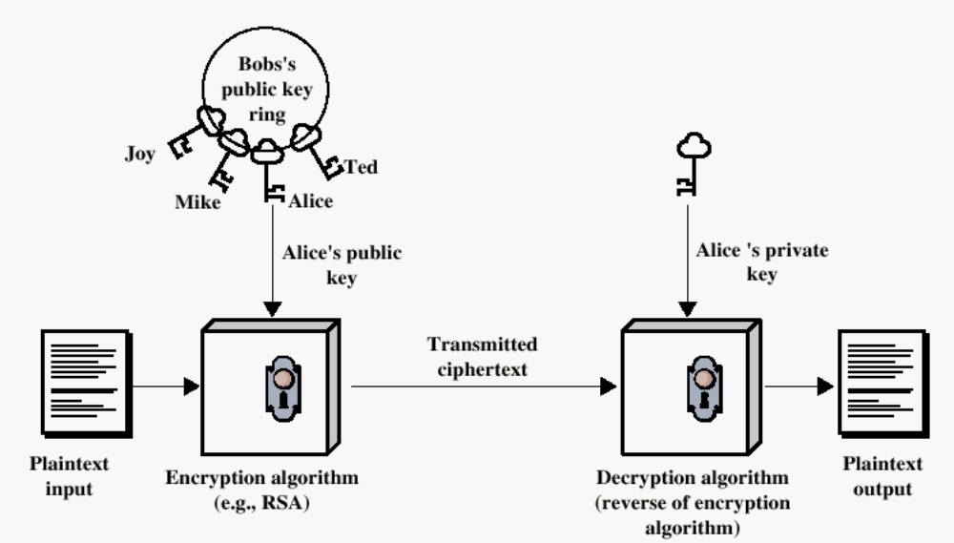
Public-Key Encryption

Slide 10
Requirements
Key generation: computationally easy to generate a pair (public key PK, private key SK)
  Computationally infeasible to determine private key PK given only public key PK
Encryption: given plaintext M and public key PK, easy to compute ciphertext C=E_{PK}(M)
Decryption: given ciphertext C=E_{PK}(M) and private key SK, easy to compute plaintext M
  Infeasible to compute M from C without SK
  Trapdoor function: Decrypt(SK,Encrypt(PK,M))=M

Slide 11
Number Theory Basics
Euler totient function ϕ(n) where n≥1 is the number of integers in the [1,n] interval that are relatively prime to n
  Two numbers are relatively prime if their greatest common divisor (gcd) is 1
  ϕ(7)=6 -> {1,2,3,4,5,6}
    gcd(7,1)=1,gcd(7,2)=1,gcd(7,3)=1,gcd(7,4)=1,
    gcd(7,5)=1,gcd(7,6)=1
  ϕ(8)=4 -> {1,3,5,7}
    gcd(8,1)=1,gcd(8,2)=2,gcd(8,3)=1,gcd(8,4)=4
    gcd(8,5)=1,gcd(8,6)=2,gcd(8,7)=1
Euler’s theorem:
  if a∈Z_{n}*, then a^{ϕ(n)}=1 mod n
Special case: Fermat’s Little Theorem
  if p is prime and gcd(a,p)=1, then a^{p-1}=1 mod p

Slide 12
RSA Cryptosystem
Key generation:
  Generate large primes p, q
    Say, 1024 bits each (need primality testing, too)
  Compute n=pq
    ϕ(n)=(p-1)(q-1) using prime factorization of n=pq
  Choose small e, relatively prime to ϕ(n)
  Compute unique d such that ed = 1 mod ϕ(n)
    d = e⁻¹ mod ϕ(n)
  Public key = (e,n); private key = (d)
Encryption of m: c = m^{e} mod n
  Modular exponentiation by repeated squaring
Decryption of c: c^{d} mod n = (m^{e})^{d} mod n = m

Slide 13
RSA Decryption
e⋅d=1 mod ϕ(n)
Thus e⋅d=1+k⋅ϕ(n)=1+k(p-1)(q-1) for some k
If gcd(m,p)=1, then m^{ed}=m mod p
  By Fermat’s Little Theorem, m^{p-1}=1 mod p
  Raise both sides to the power k(q-1) and multiply by m
  m^{1+k(p-1)(q-1)}=m mod p, thus m^{ed}=m mod p
By the same argument, m^{ed}=m mod q
Since p and q are distinct primes and p⋅q=n,
  m^{ed}=m mod n

Slide 14
Exponent Computation
Complexity of Enponentiation can be reduced using square and multiply approach
  2⁷=2*2*2*2*2*2*2
  2⁷=2⁴ * 2² * 2¹
  2⁴= 2² * 2²
  2²= 2 * 2
Use binary representation of exponent
  7 in binary is 111, 2⁷=2⁴ * 2² * 2¹
  5 in binary is 101, 2⁷=2⁴ * 2¹

Slide 15
Security of RSA
RSA problem: given n=pq, e such that
gcd(e,(p-1)(q-1))=1 and c, find m such that
m^{e}=c mod n
  i.e., recover m from ciphertext c and public key (n,e) by taking e^{th} root of c
  There is no known efficient algorithm for doing this
Factoring problem: given positive integer n, find primes p₁, …, p_{k} such that n=p₁^{e1}p₂^{e2}…p_{k}^{ek}
If factoring is easy, then RSA problem is easy, but there is no known reduction from factoring to RSA
  It may be possible to break RSA without factoring n

Slide 16
RSA Example
Select two prime numbers p, q
  p=17,q=11
Calculate n =p*q
  n=17*11=187
Calculate ϕ(n)=(p-1)*(q-1)
  ϕ(n)=16*10=160
Select e such gcd(e,ϕ(n))=1, gcd(e,160)=1
  e = 7
Determine d such de=1 mod ϕ(n)
  d=23, 23*7=161=1 mod 160
Encrypt 88
  88⁷ mod 187 = 11
Decrypt 11
  11²³ mod 187 - 88

Slide 17
Integrity in RSA Encryption
Plain RSA does not provide integrity
  Given encryptions of m₁ and m₂, attacker can create encryption of m₁⋅m₂
    (m₁e) ⋅ (m₂e) mod n = (m₁⋅m₂)^{e} mod n
  Attacker can convert m into m^{k} without decrypting
    (m₁e)^{k} mod n = (m^{k})^{e} mod n
In practice, Optimal Asymmetric Encryption Padding is used: instead of encrypting M, encrypt M⊕G(r) | r⊕H(M⊕G(r))
  r is random and fresh, G and H are hash functions
  Resulting encryption is plaintext-aware: infeasible to compute a valid encryption without knowing plaintext
    … if hash functions are “good” and RSA problem is hard

Slide 18
Digital Signatures
public key
private key
Alice
Bob
Given: Everybody knows Bob’s public key
Only Bob knows the corresponding private key
Goal: Bob sends a “digitally signed” message
    To compute a signature, must know the private key
    To verify a signature, enough to know the public key

Slide 19
RSA Signatures
Public key is (n,e), private key is d
To sign message m: s = m^{d} mod n
  Signing and decryption are the same operation in RSA
  It’s infeasible to compute s on m if you don’t know d
To verify signature s on message m:
s^{e} mod n = (m^{d})^{e} mod n = m
  Just like encryption
  Anyone who knows n and e (public key) can verify signatures produced with d (private key)
In practice, also need padding & hashing

Slide 20
Digital Signature Standard
U.S. government standard (1991-94)
  Modification of the ElGamal signature scheme (1985)
Key generation:
  Generate large primes p, q such that q divides p-1
    2¹⁵⁹ < q < 2¹⁶⁰, 2^{511+64t} < p < 2^{512+64t} where 0≤t≤8
  Select h∈Z_{p}* and compute g=h^{(p-1)/q} mod p
  Select random x such 1≤x≤q-1, compute y=g^{x} mod p
Public key: (p, q, g, y=g^{x} mod p), private key: x
Security of DSS requires hardness of discrete log
  If could solve discrete logarithm problem, would extract x (private key) from g^{x} mod p (public key)

Slide 21
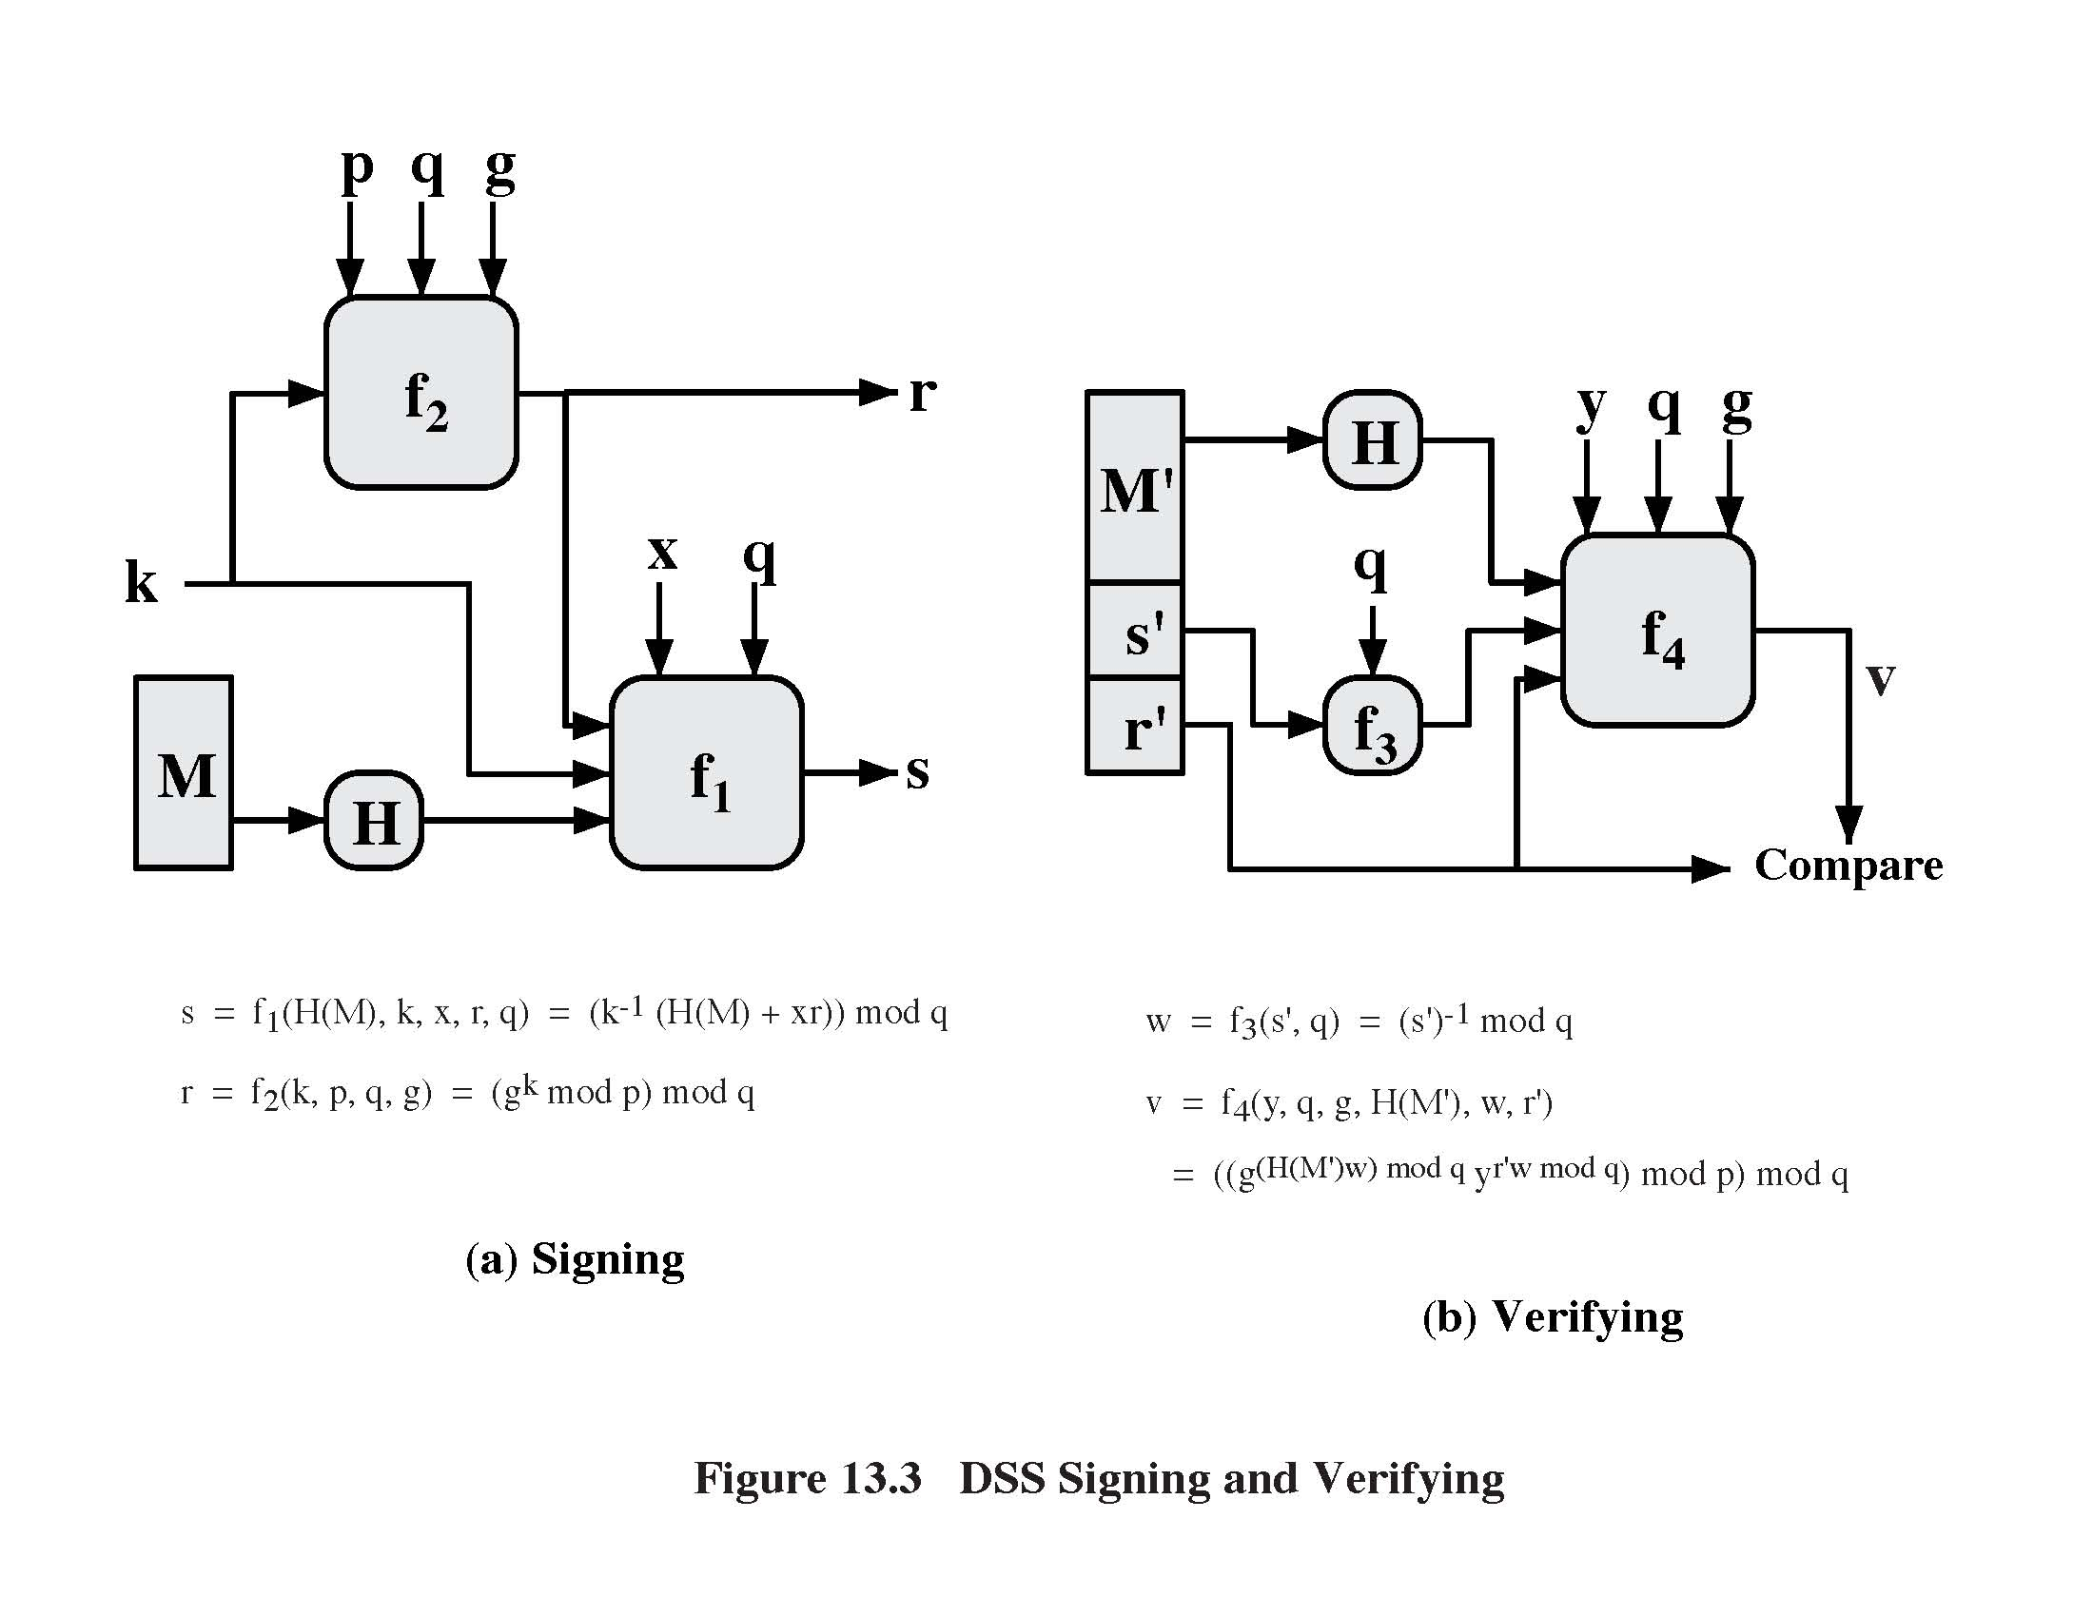
Signing a Message
Compute r = (g^{k} mod p) mod q
Private key
Random secret
between 0 and q
(r,s) is the
signature on M
Message
Hash function
(SHA-1)
Compute s = k⁻¹⋅(H(M)+x⋅r) mod q

Slide 22
Verifying a Signature
Public key
Message
Compute (g^{H(M’)w} ⋅ y^{r’w mod} ^{q} mod p) mod q
Signature
Compute w = s’⁻¹ mod q
If they match, signature is valid
(i.e., it was produced by someone who knows
private key x)

Slide 23
DSS Verification
If (r,s) is a legitimate signature, then
r = (g^{k} mod p) mod q ; s = k⁻¹⋅(H(M)+x⋅r) mod q
Thus H(M) = -x⋅r+k⋅s mod q
  Multiply both sides by w=s⁻¹ mod q
H(M)⋅w + x⋅r⋅w = k mod q
  Exponentiate g to both sides
(g^{H(M)⋅w + x⋅r⋅w} = g^{k}) mod p mod q
  In a valid signature, g^{k} mod p mod q = r, g^{x} mod p = y
Verify g^{H(M)⋅w}⋅y^{r⋅w} = r mod p mod q

Slide 24
Security of DSS
Can’t create a valid signature without private key
Given a signature, hard to recover private key
Can’t change or tamper with signed message
If the same message is signed twice, signatures are different
  Each signature is based in part on random secret k
Secret k must be different for each signature!
  If k is leaked or if two messages re-use the same k, attacker can recover secret key x and forge any signature from then on

Slide 25
Advantages of Public-Key Crypto
Confidentiality without shared secrets
  Very useful in open environments
  No “chicken-and-egg” key establishment problem
    With symmetric crypto, two parties must share a secret before they can exchange secret messages
Authentication without shared secrets
  Use digital signatures to prove the origin of messages
Reduce protection of information to protection of authenticity of public keys
  No need to keep public keys secret, but must be sure that Alice’s public key is really her true public key

Slide 26
Disadvantages of Public-Key Crypto
Calculations are 2-3 orders of magnitude slower
  Modular exponentiation is an expensive computation
  Typical usage: use public-key cryptography to establish a shared secret, then switch to symmetric crypto
Keys are longer
  1024 bits (RSA) rather than 128 bits (AES)
Relies on unproven number-theoretic assumptions
  What if factoring is easy?
    Factoring is believed to be neither P, nor NP-complete

